Slide 1

Titanic project

Slide 2
INTRODUCTION
In this project, we will build a machine learning model to predict Survived people based on a given, labeled dataset.
You will walk through the different steps of the building process: exploring, visualizing and cleaning the data. Then, selecting the best model and model evaluation.

Slide 3
CONTENTS OF THIS TEMPLATE
#1 Look At The Big Picture
#2 Get The Data
#3 Discover and Visualize the Data to Gain Insights
#3.1 Discover the Data.
#3.2 Visualize the Data.
#4 Prepare the Data for Machine Learning Algorithms
#5 Select and Train a Model

Slide 4
#1 Look At The Big Picture
problem? Classification
Type of machine learning system?
Supervised / Unsupervised
Batch Learning / Online Learning
Instance Based / Model Based

Slide 5
1
Get the data

Slide 6
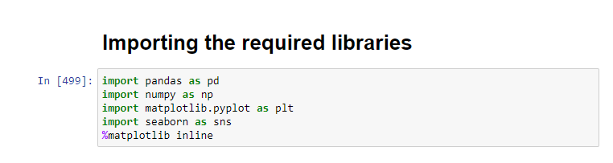
# Importing the required libraries

Slide 7
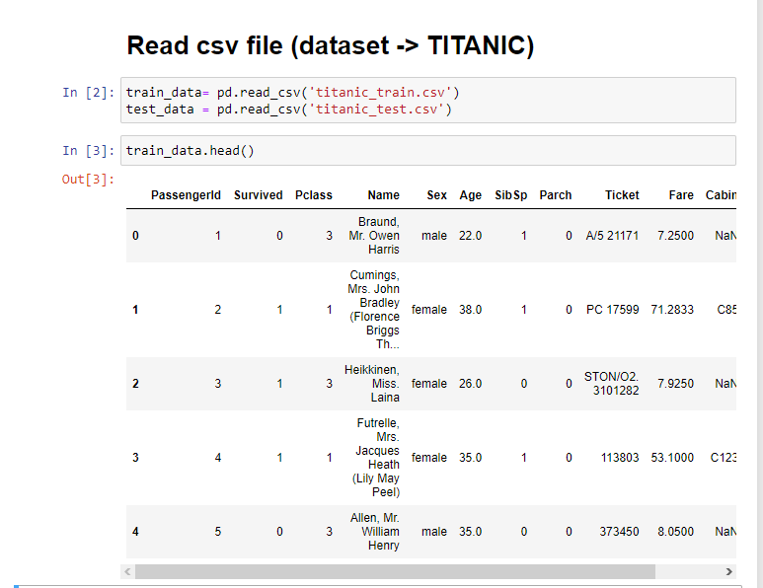
#3 Get the data

Slide 8
#Variable Description .
1.PassengerId: unique number to each passenger
2.Survived: passenger survived:1 or died:0
3.Pclass: passenger class
4.Name: name
5.Sex: gender of person
6.Age: age of person
7.SibSp: number of siblings/spouses
8.Parch: number of parents/children
9.Ticket: ticket number
10.Fare: amount of money spent on ticket
11.Cabin: cabin category
12.Embarked: port where passenger embarked(C = Cherbourg, Q = Queenstown, S = Southampton)

Slide 9
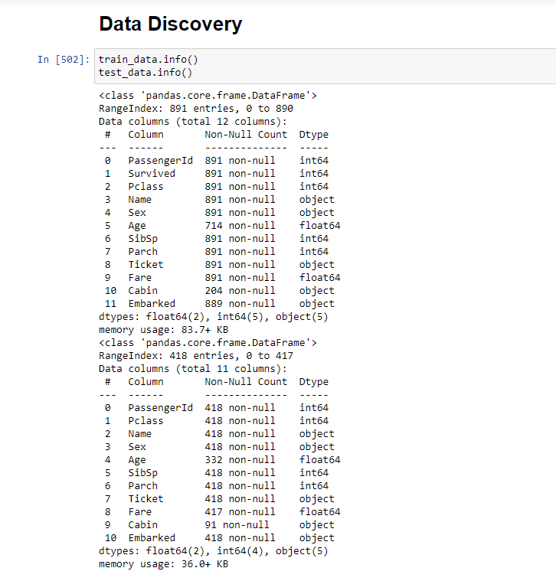
#Data Discovery
#Notice that there are 891 values in train data and 418 values in test data .
#There is null values in Age , Cabin , Embarked in train data and Age,Fare in test data .

Slide 10
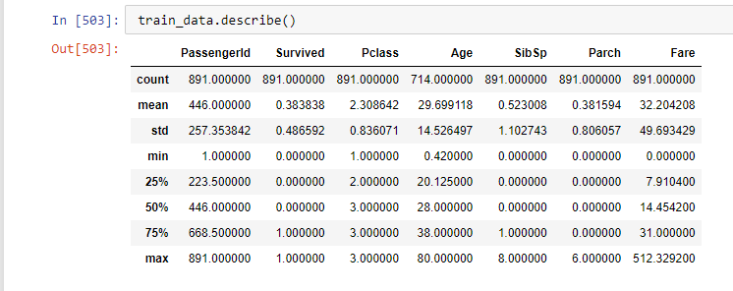
Describe the data summary of the numerical attributes

Slide 11
2
Discover and Visualize the Data to Gain Insights
.

Slide 12
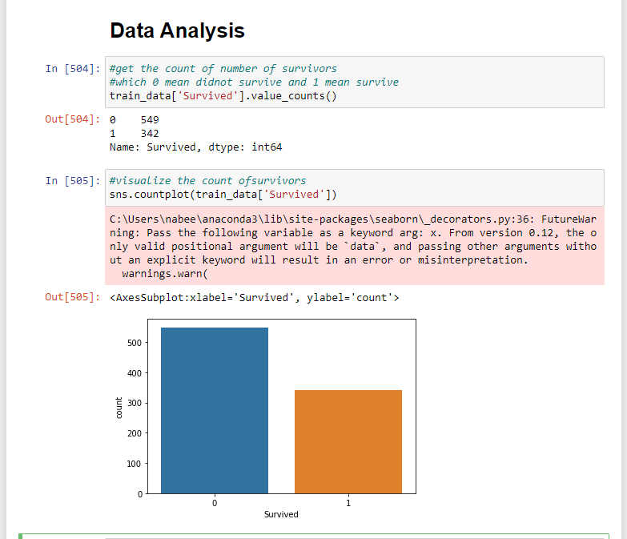
Data Analysis

Slide 13
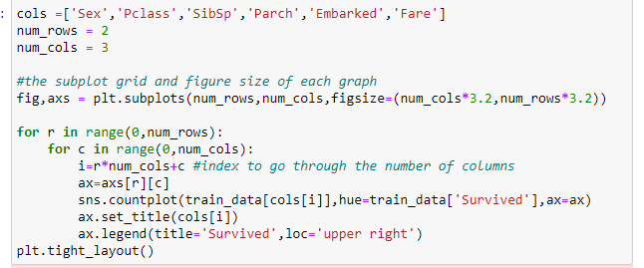
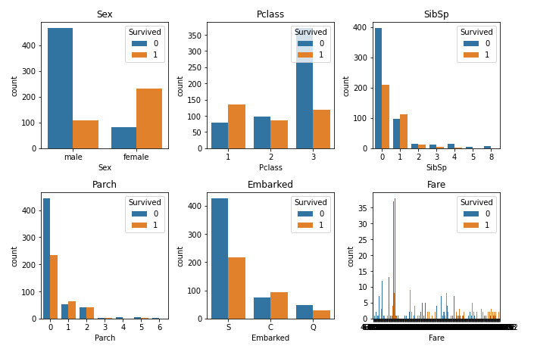
A quick way to get a general look at the data is plotting .
#The relationship between survival and other features.
#This is a count plots for the number of passengers who did survived and who did not survived.
#passenger survived:1 or died:0.

Slide 14
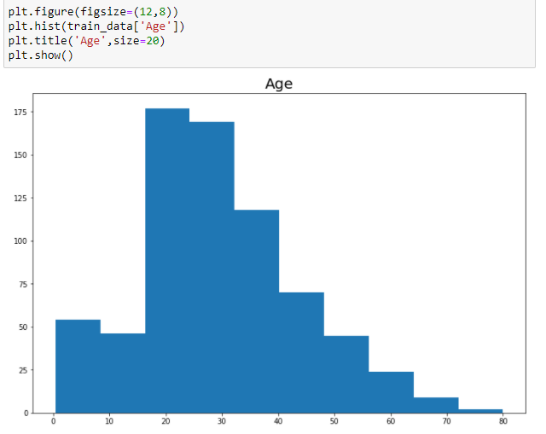
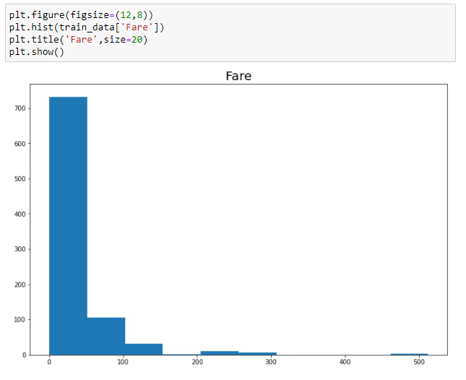
Plot a histogram for Age and Fare

Slide 15
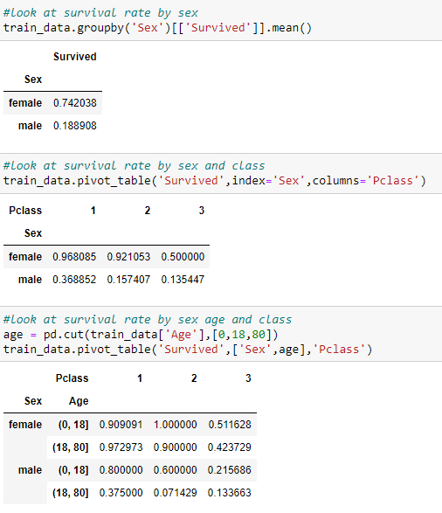
#look at survival rate
You would be lucky if you a female , in the first class and your age between (18,80].
And if you a male , good luck to survive.
TITANIC FACTS
Total On Board Total: 2226 Died: 1523 Survived: 703 % Survived: 32% | Total Men Total: 1680 Died: 1357 Survived: 323 % Survived: 19% | Total Children Total: 112 Died: 56 Survived: 56 % Survived: 50% | Total Women Total: 434 Died: 110 Survived: 324 % Survived: 75%

Slide 16
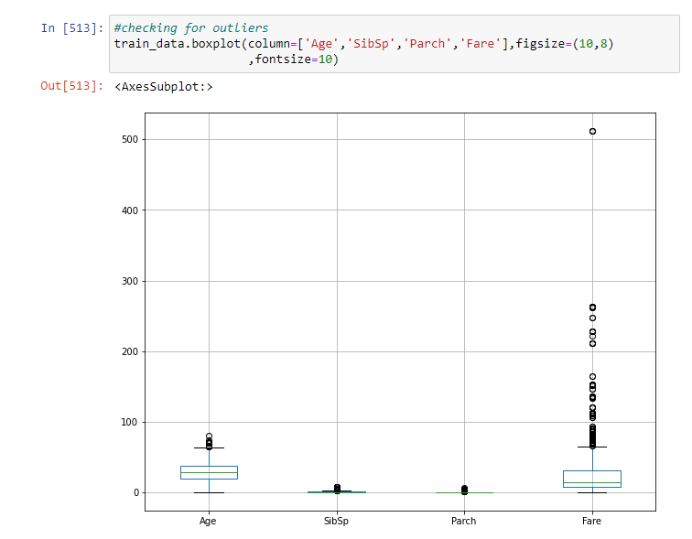
# Plot for Outliers

Slide 17
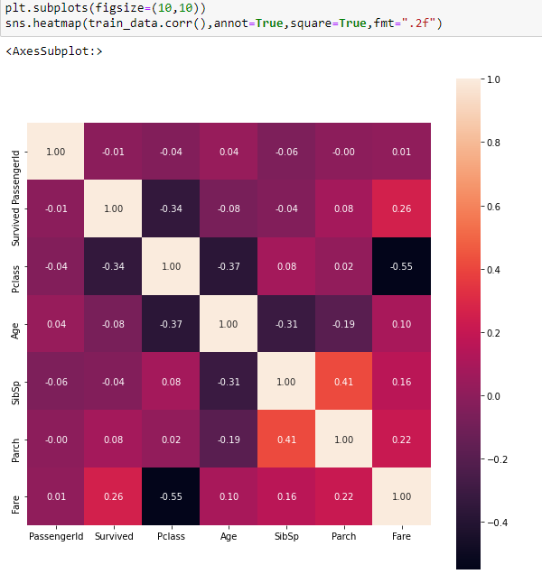
# Pairwise Correlation
#

Slide 18
3
Prepare the Data for Machine Learning Algorithms

Slide 19
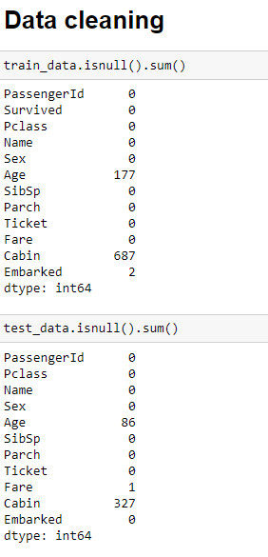
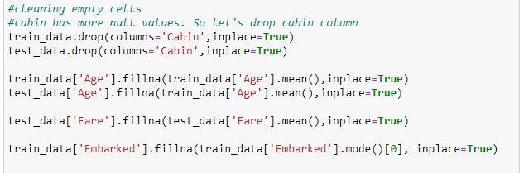
#Data Cleaning
1# In the dataset we will fill the null values for age in mean.
2# we will drop the cabin in the dataset because it has a lot of null value.
3# In the train data we will fill the null values for embarked in mode .
4# In the test set we will fill the null values for fare in mean.

Slide 20
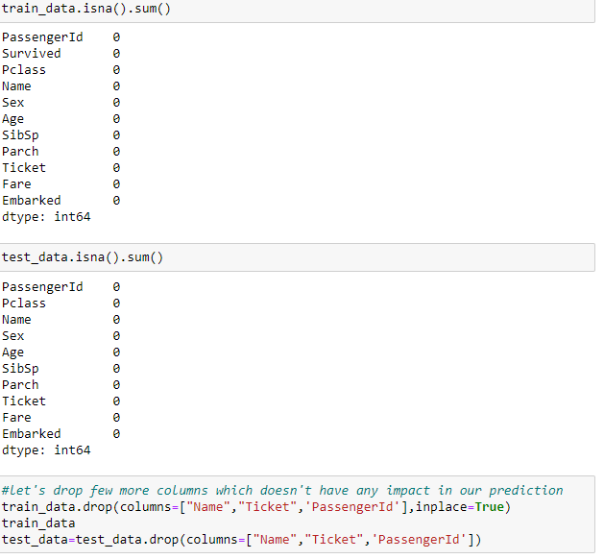
Checking for the missing values !
We dropped the Name , Ticket and the passenger Id which does not have any impact in our prediction.

Slide 21
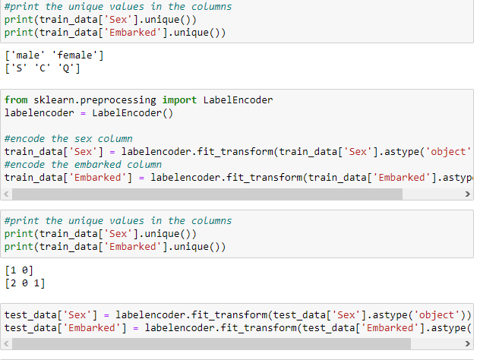
#Handling Text and Categorical Attributes
After encode the
Sex
1 | male
0 | female
Embarked
 | 2 | S
 | 0 | C
 | 1 | Q

Slide 22
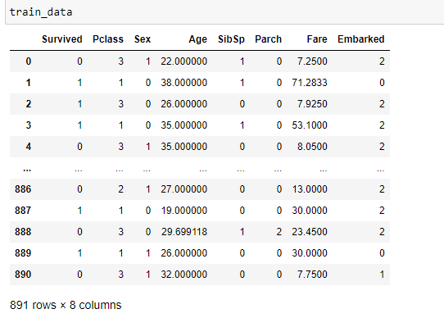
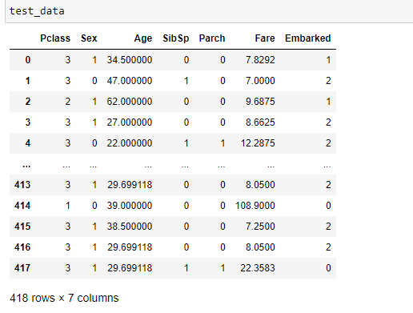
Now the data is ready.

Slide 23
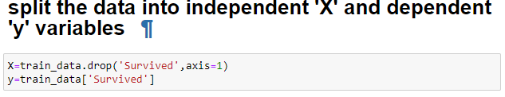
X ,y
let’s separate the
predictors ( survived (dependent variable [y]))
and the other attributes ( independent variable [ X ])

Slide 24
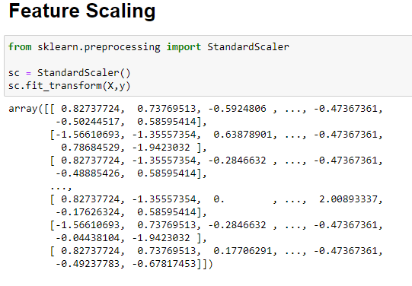
# Feature scaling
I tried to make a scale just for X , but the accuracy was less so I make scale for X and y.

Slide 25
4
Create a test set .

Slide 26
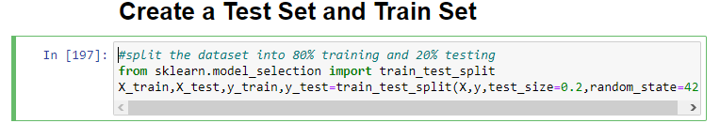
Spliting the data
# Split the dataset into 80% training and 20% testing.
# Also I tried to split the dataset into 70% training and 30% testing but I get less accuracy.
What is (random_state = 42) ? If you run the program again (without any random state ) the program will generate a different test set! So over time, the program will see the whole dataset, which is what you want to avoid. We set the random number generator’s seed ( random_state= 42), so it always generates the same test set.

Slide 27
5
Select & train the model

Slide 28
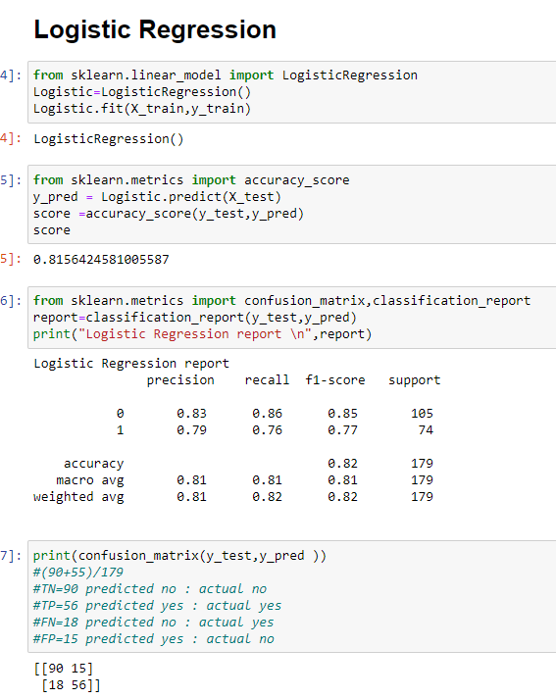
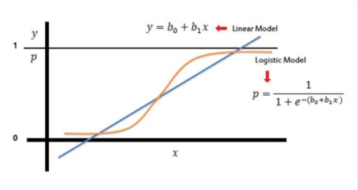
Logistic Regression

Slide 29
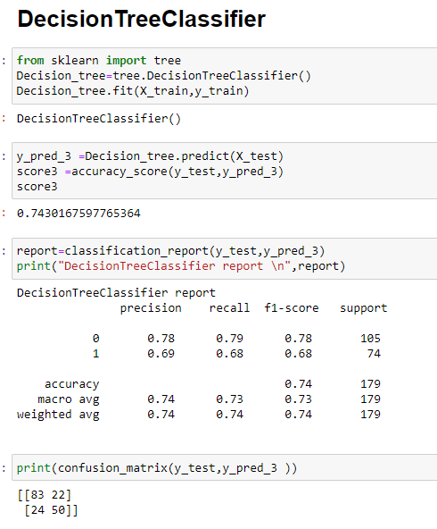
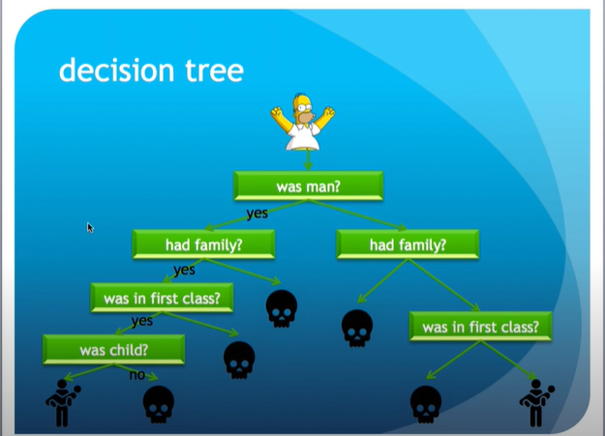
Decision Tree Classifier

Slide 30
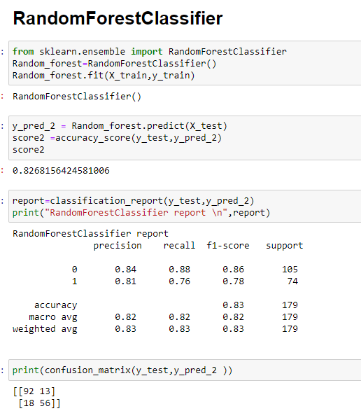
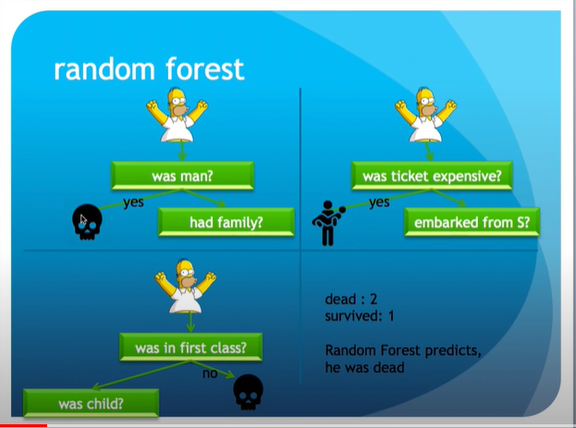
Random Forest Classifier

Slide 31
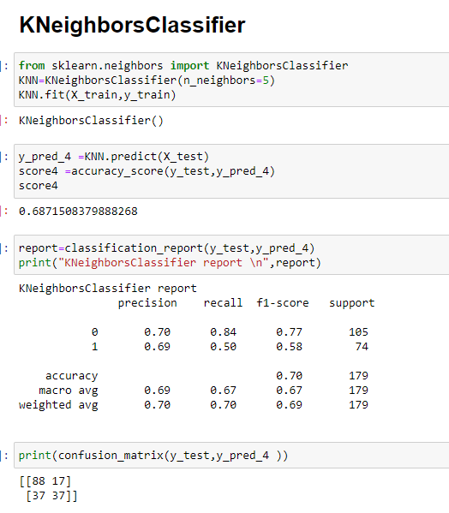
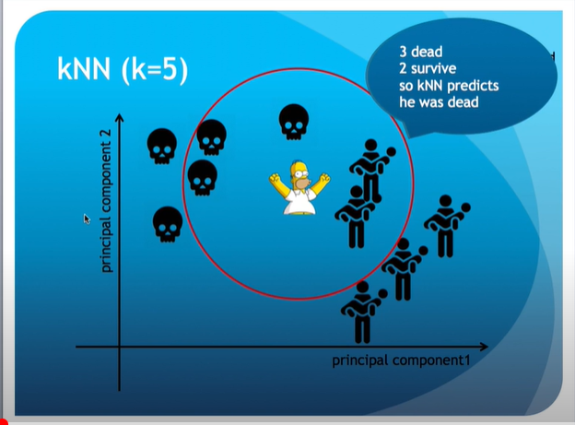
K Neighbors Classifier

Slide 32
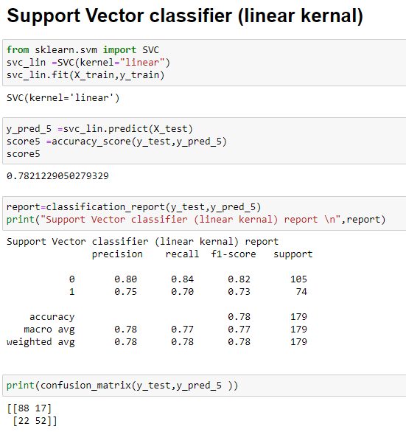
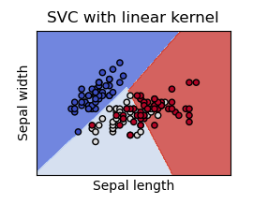
Support Vector classifier (linear kernal)

Slide 33
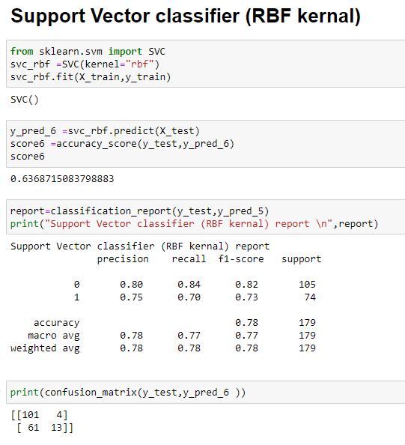
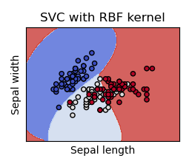
Support Vector classifier (RBF kernal)

Slide 34
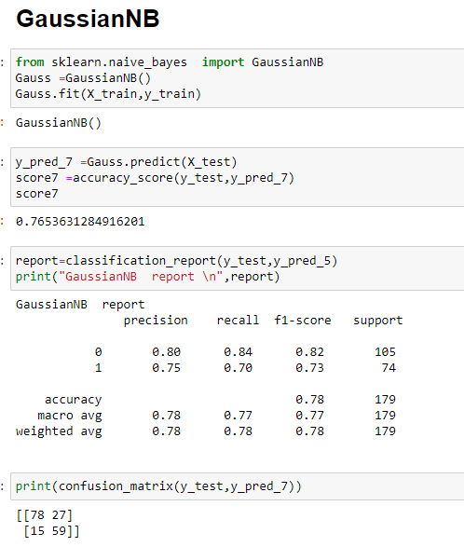
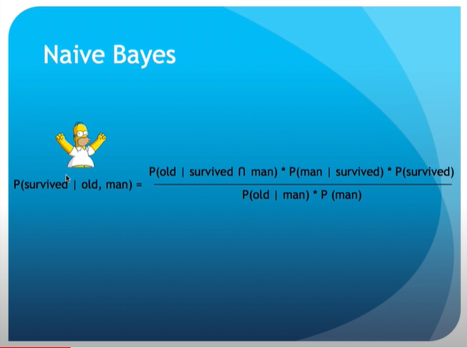
GaussianNB

Slide 35
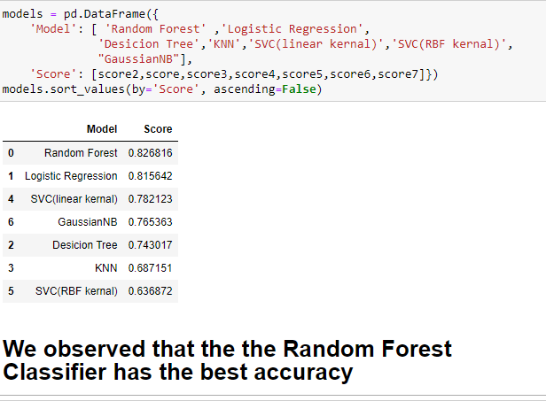
The best model
We applied 7 models on data and we noticed that the best model was Random Forest Classifier with an accuracy =0.826816.

Slide 36
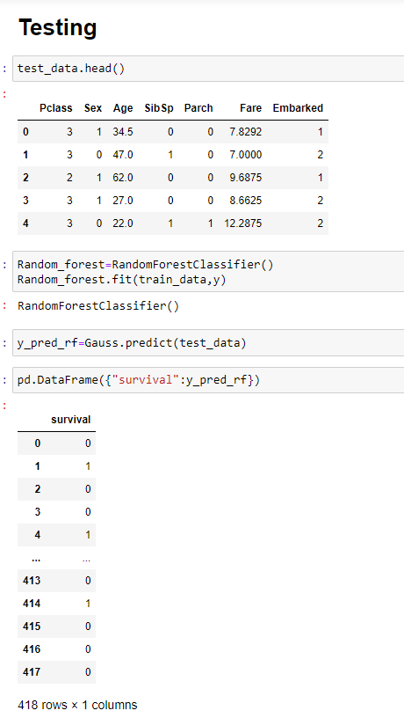
Testing
After we saw the best model Random Forest Classifier ,we applied the test data in this model and we stored it in the data frame.

Slide 37
THANK YOU!
Rama Al-Marhlh

